Slide 1
Chatty - A Progressive Web app Powered by a REST backend
01
Link to App(http://edwinclement08.tk:8080/pages/build/index.html), Served on My PC, If not Reachable at the link, contact (+91 98335 82185)

Slide 2
Web Interface - React based

Slide 3
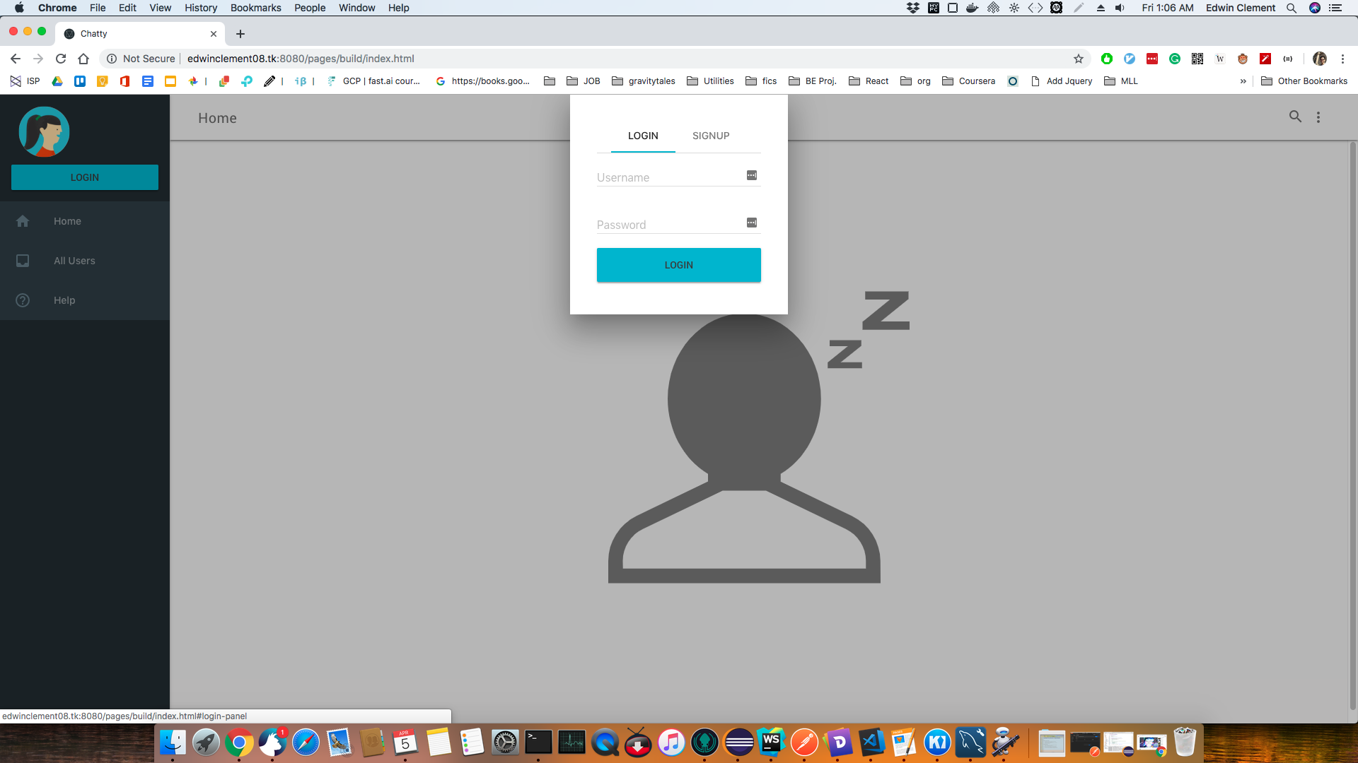
Start/Login

Slide 4
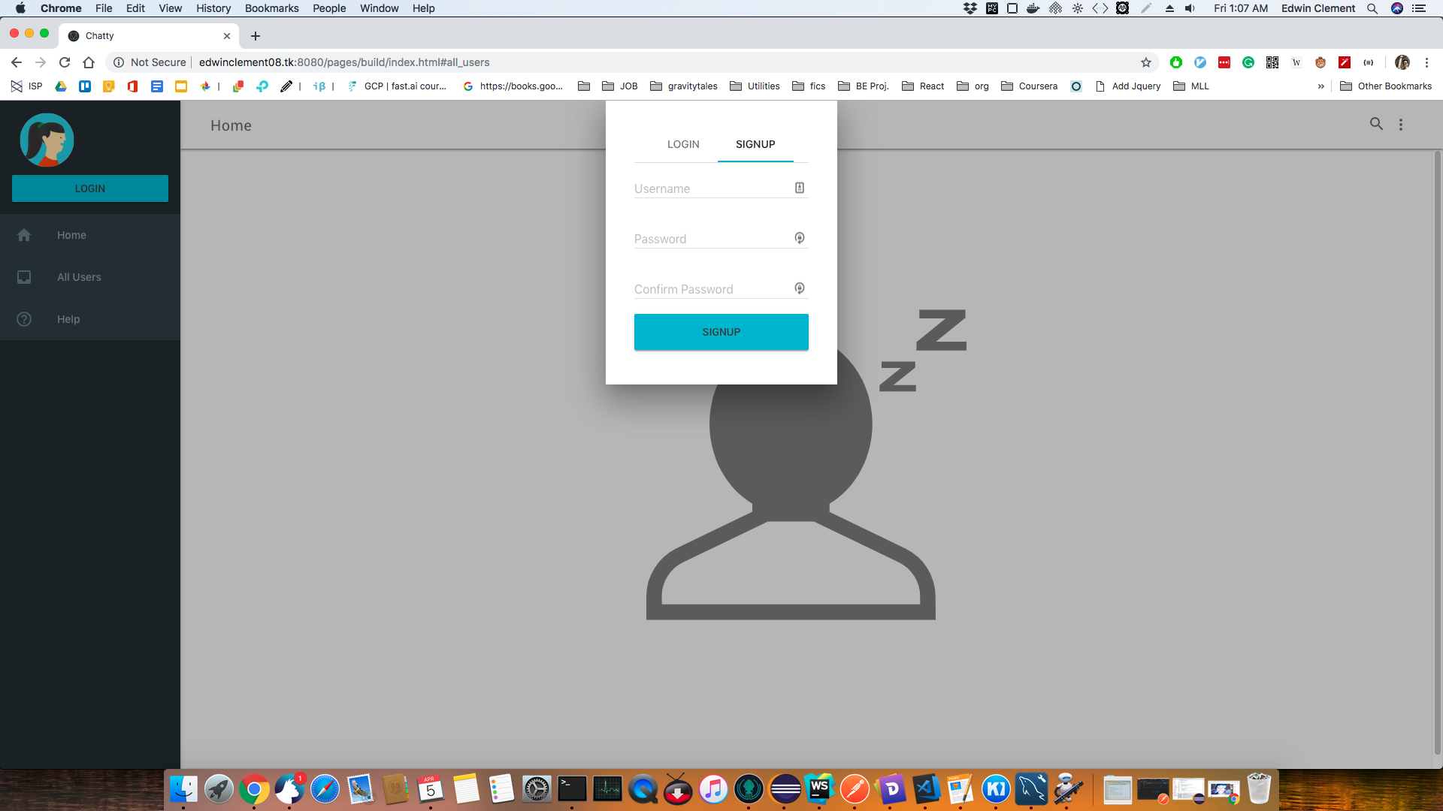
Signup

Slide 5
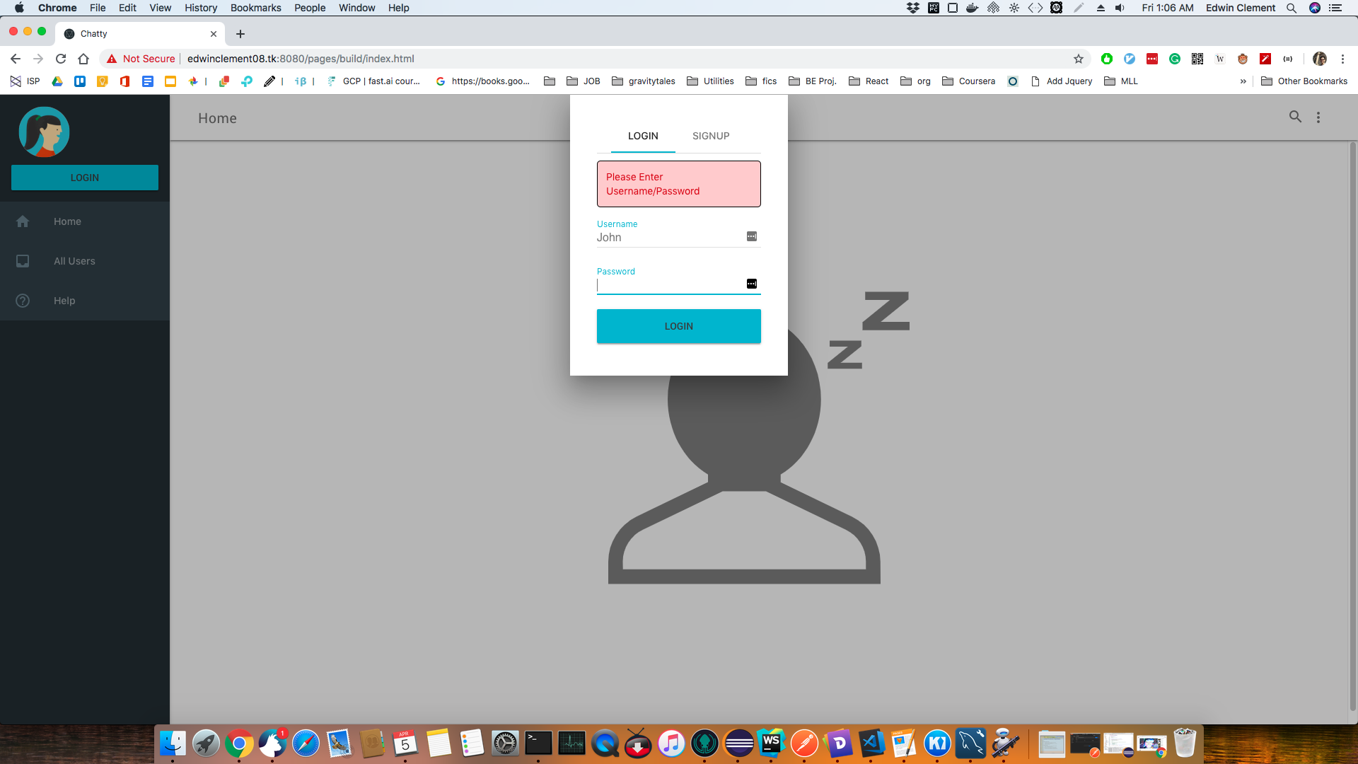
Login not filled

Slide 6
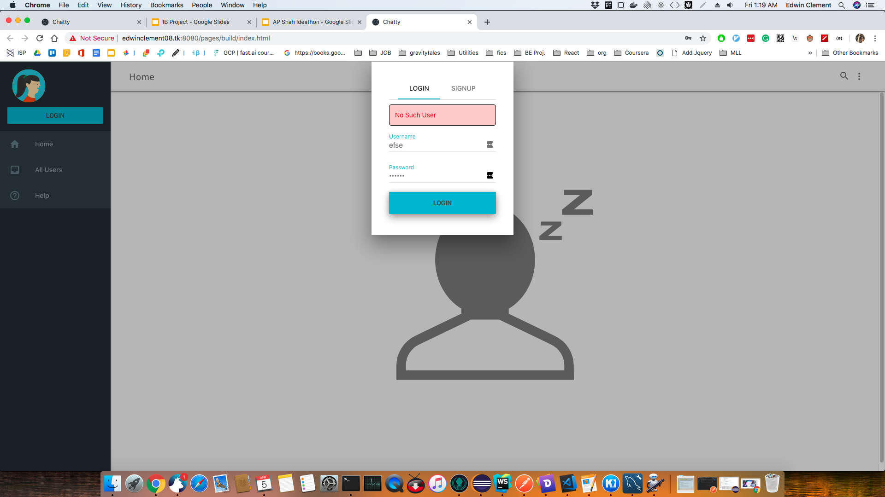
Login Wrong

Slide 7
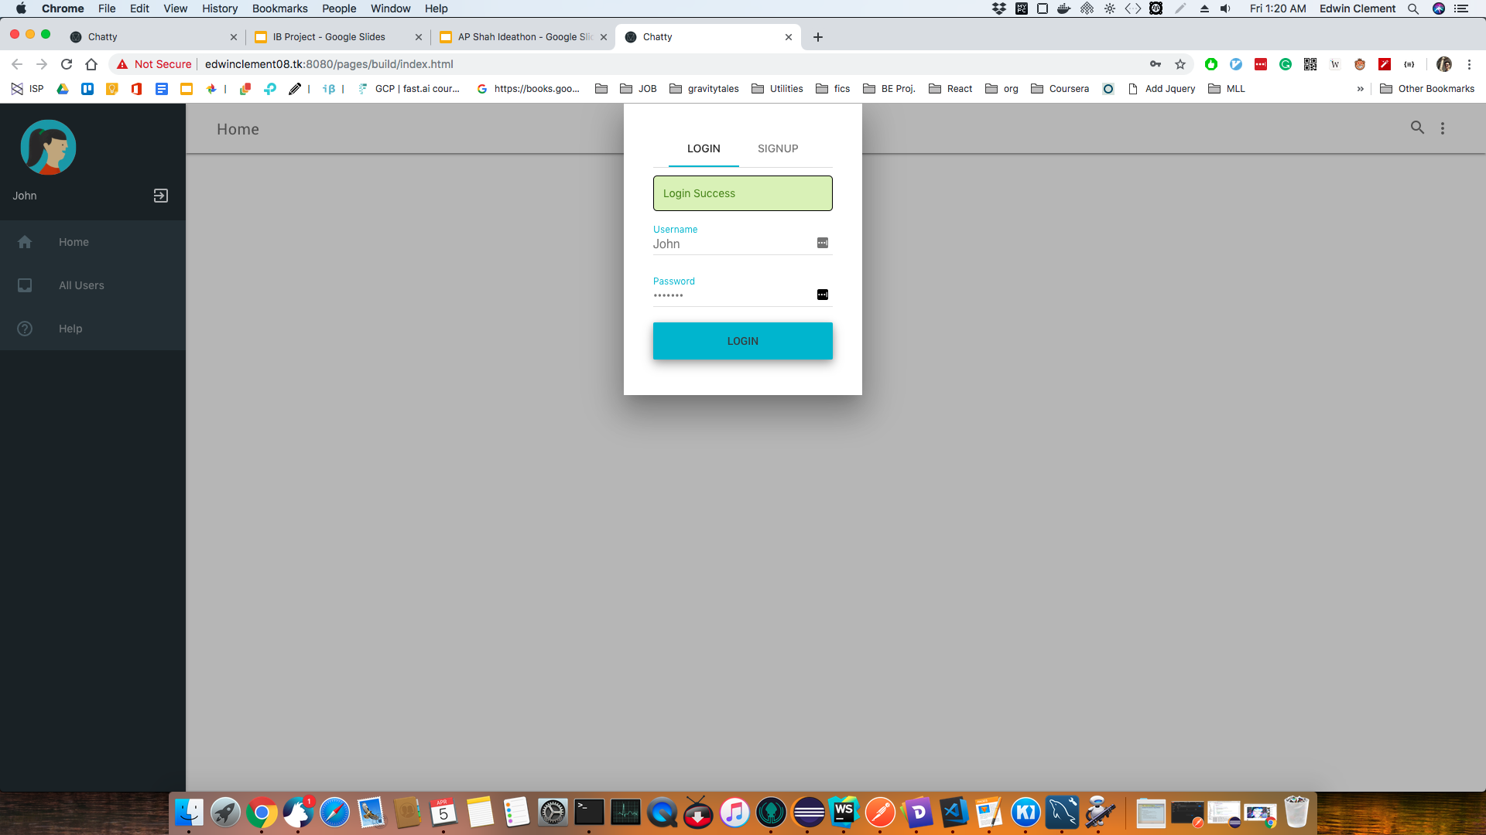
Login Success

Slide 8
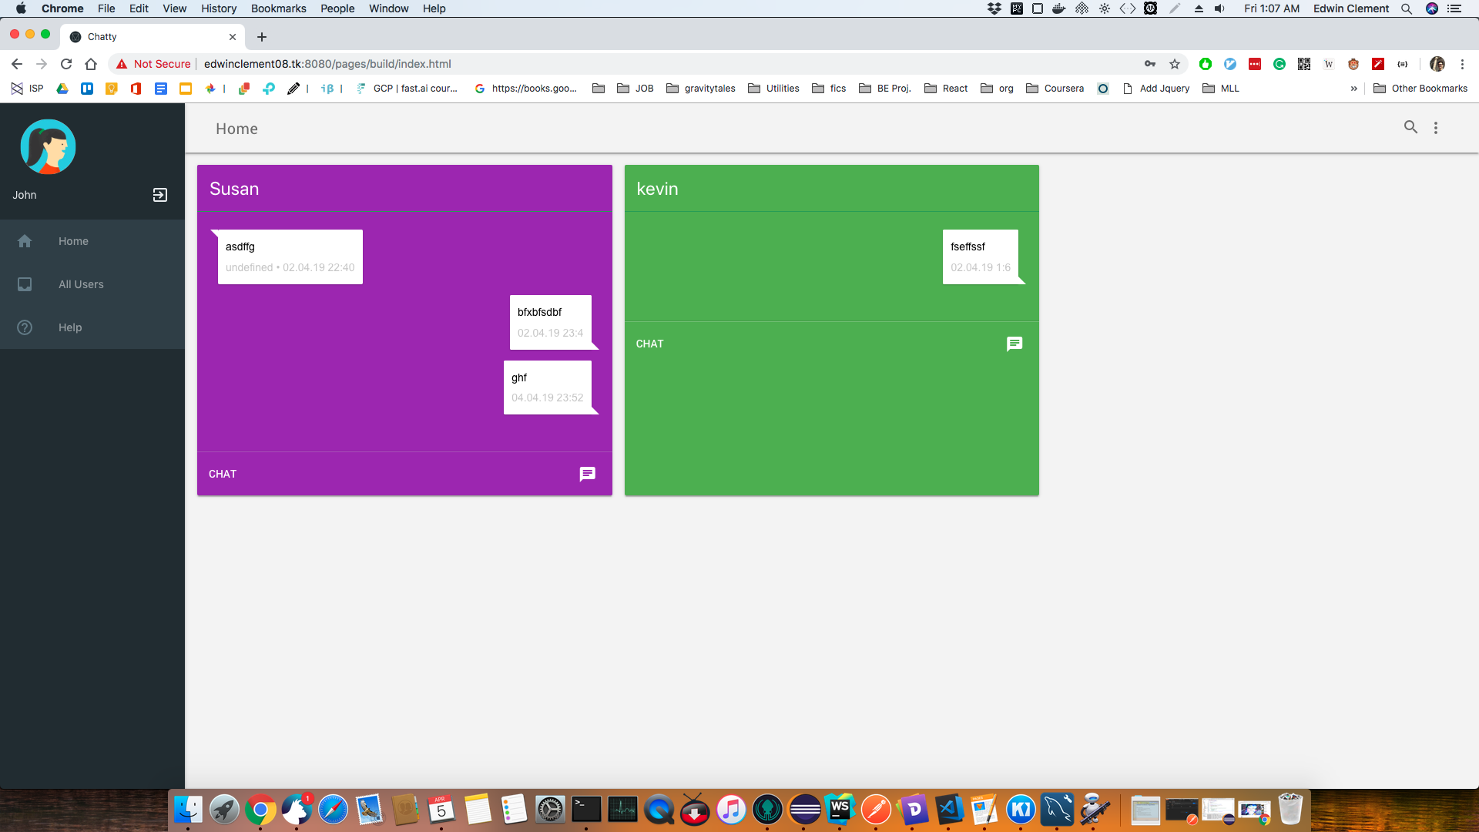
Friends List

Slide 9
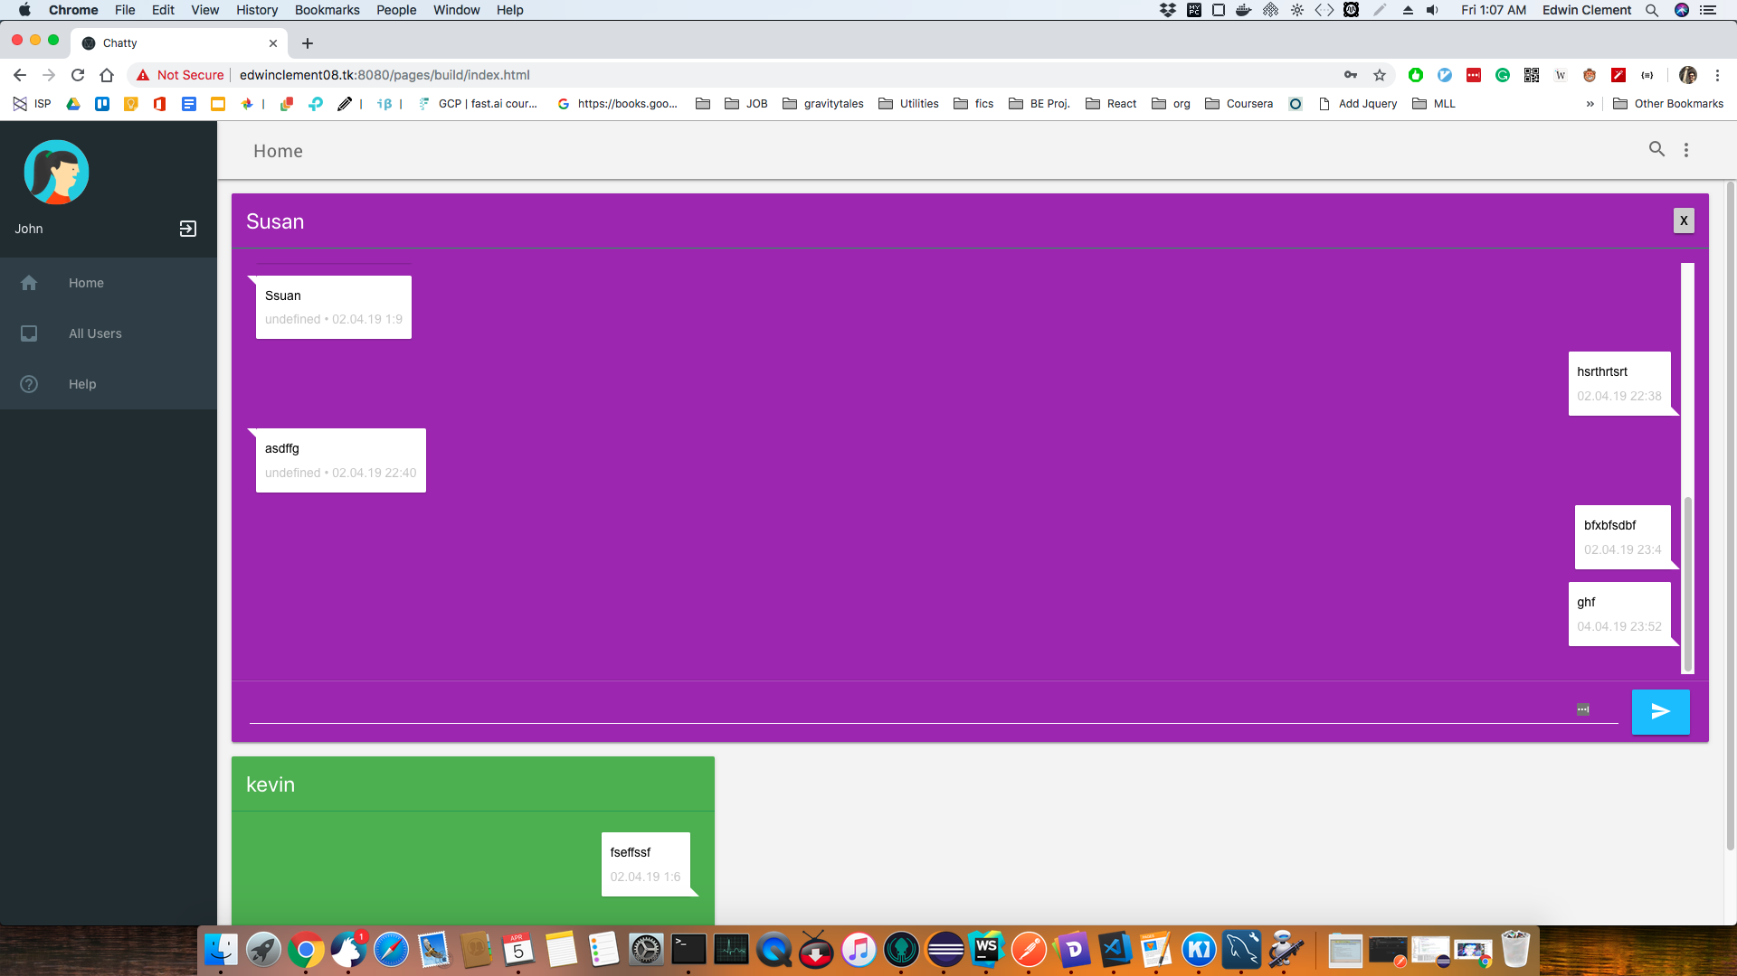
Chat Screen List

Slide 10
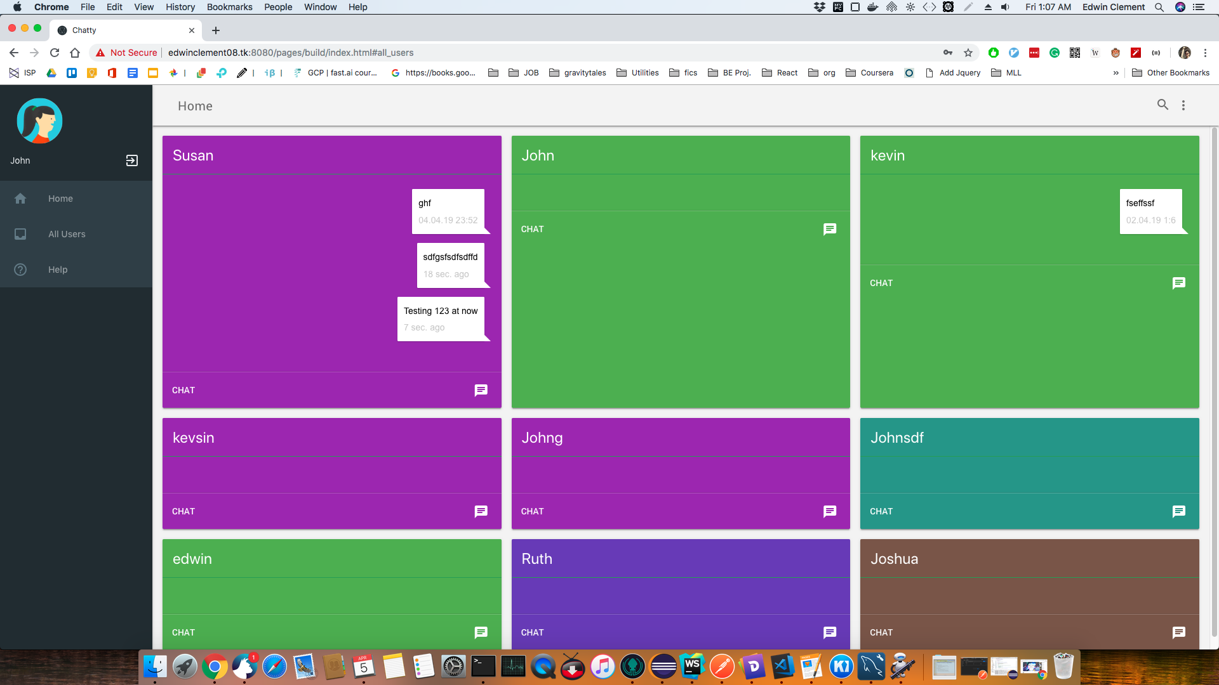
All User List

Slide 11
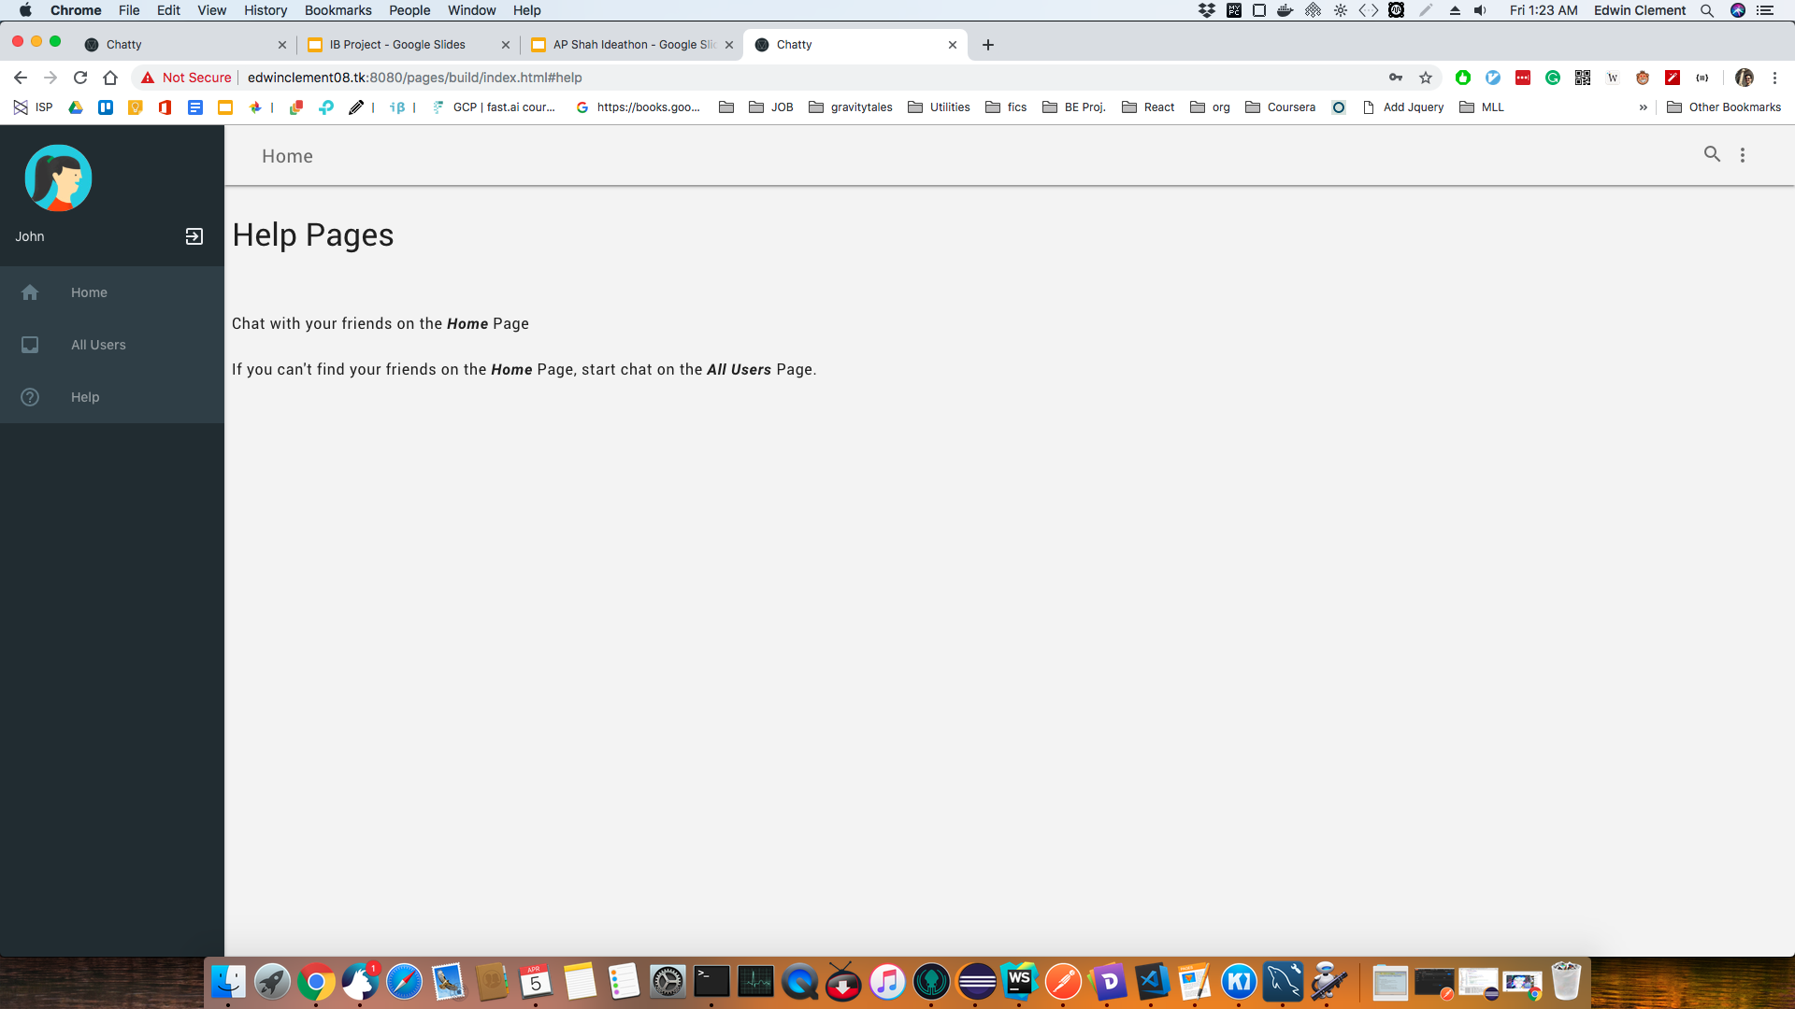
Help Screen

Slide 12
Mobile Interface

Slide 13
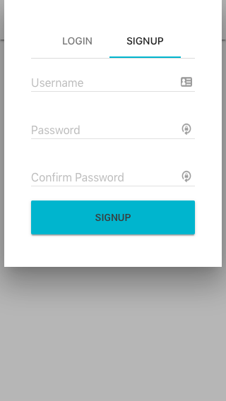
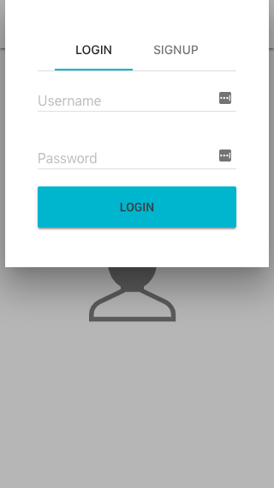
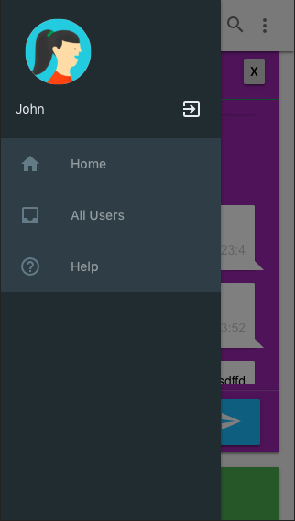
Signup
Login
Sidebar

Slide 14
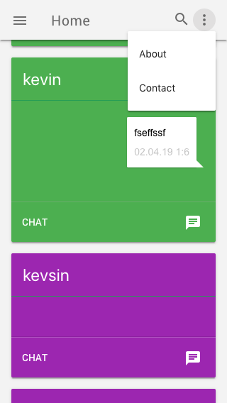
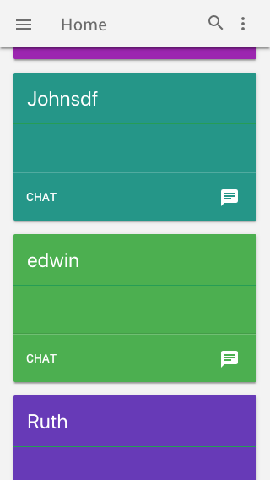
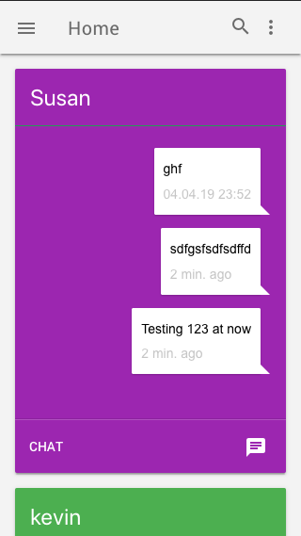
Context Menu
All Users
Chat Screen

Slide 15
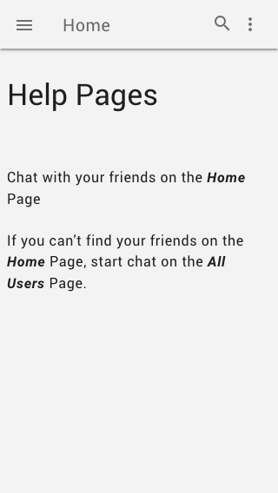
Help

Slide 16
Implementation Details
Rest Server implemented with Jersey (JAX-RS API)
Stateless server(no User Session Data stored at server)
Token based Auth after initial Login
Single Page App, using AJAX Requests for updates
No Page Reload Required for New Chat Messages

Slide 17
Rest Endpoints
/rest/user:
/ : List of Users
/details : List of Users with all details that are stored in DB(not for prod.)
/register : Register new details
/update : Update user details
/login : Login as a user
/delete : Delete a user
/rest/message:
/sendMessage : Send a Message from a user to another user
/getUserFriends : Get all Friends(users previously chatted with user) for a user
/peekMessages : Get last few Messages sent to a user from another user
/getAllMessages : Get all Messages sent to a user from another user
/getNewMessages : Get new Messages sent to a user from another user

Slide 18
Thanks for your time.

